Slide 1
Building a recommender system using graph neural network
Weifeng Ma
Aman Shah

Slide 2
Agenda
Popular based recommender system(RS)
Collaborative filtering
Graph neural network RS

Slide 3
Introduction
Recommendation systems are complex artificial intelligence systems that are designed to provide a prediction to users based on a preference. Recommendation systems require large data and time to train. Recommendation systems are heavily used in everyday life. Recommendation systems are widely useful because they save users a lot of time on the search, and they can efficiently provide services to users.

Slide 4
Topic one
Popular based RS

Slide 5
Popular based RS
In this popular-based approach, we will filter out data and get the top and most popular items for users. This approach often use to create a top list for users to select items they might like.

Slide 6
Topic two
Collaborative Filtering RS

Slide 7
Collaborative filtering based RS
In collaborative filtering approach, the system will filter out items that a user might like on the basis of reactions by similar users. This approach is often done by using matrix factorization.

Slide 8
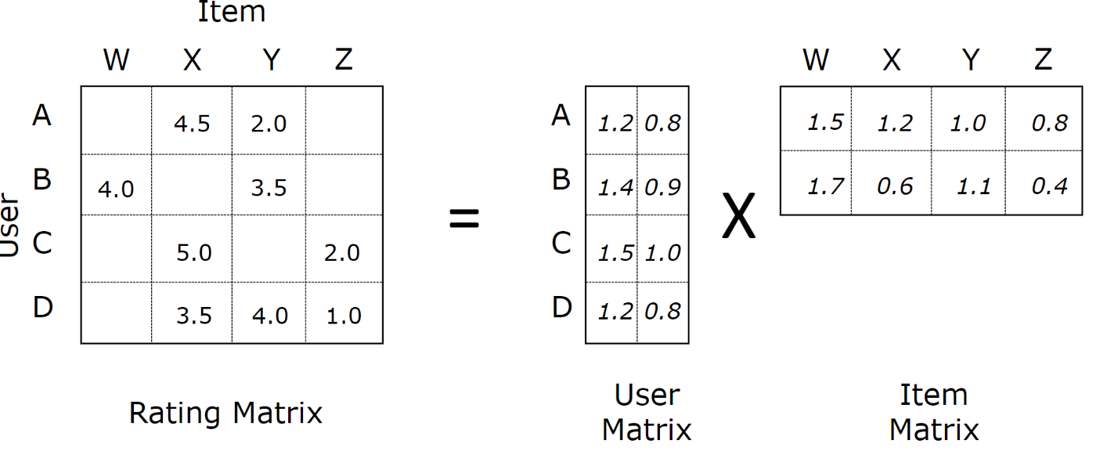
Matrix Factorization
Matrix factorization is a collaborative filtering algorithm to find the relationship between items and users’ entities.

Slide 9
Topic two
GNNs RS

Slide 10
GNNs
Graph neural networks allow us to easily to work with users and items. In Graph neural network (GNN) based recommendation system, where interactions of user-item are taken into consideration. Both interactions and opinions are encoded to build a user-item graph in the proposed approach.

Slide 11
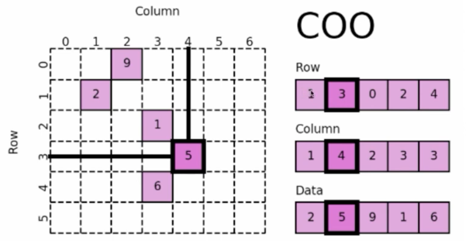
Coordinate List(COO)

Slide 12
LightGCN

Slide 13
Demo
Colab: https://colab.research.google.com/drive/1xBnc36PJ_d82BS01plDYwPomoqQL0ojU#scrollTo=5b7f792e

Slide 14
Summary
Popular based RS:
for design top list, popular list
Collaborative filtering RS:
for find interaction between users and items
GNNs for RS:
to enhance collaborative filtering

Slide 15
Reference
[1] https://medium.com/@connectwithghosh/simple-matrix-factorization-example-on-the-movielens-dataset-using-pyspark-9b7e3f567536 [2] https://towardsdatascience.com/graph-neural-network-gnn-architectures-for-recommendation-systems-7b9dd0de0856#:~:text=GNNs%20for%20recommendation,-Recommendation%20systems%20are&text=Recommendations%20are%20drawn%20from%20the,item%20past%20interactions. [3] https://link.springer.com/article/10.1007/s00521-020-05667-z
[4] https://medium.com/stanford-cs224w/lightgcn-for-movie-recommendation-eb6d112f1e8

Slide 16
Thank you

